Slide 1
DIAS: Decentralizing Internet Applications and Services
Midterm Presentation
3/13/14
Adriana Flores
Clayton Shepard
Ellis Giles
Haiuhua Shen
Yanda Lu

Slide 2
Agenda
Background & Motivation
Dias Overview
Related Work
DIAS Framework
Progress
Demo
Remaining Work

Slide 3
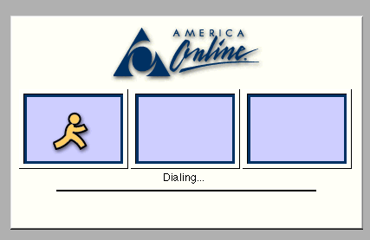
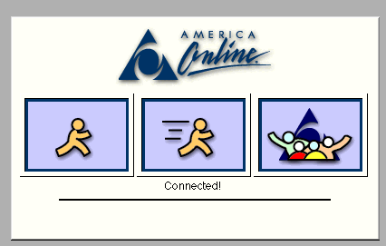

Motivation - Before
Rare users have persistent always-on connections.
Instead, servers were always connected to the internet
Intermediary for communication

Slide 4
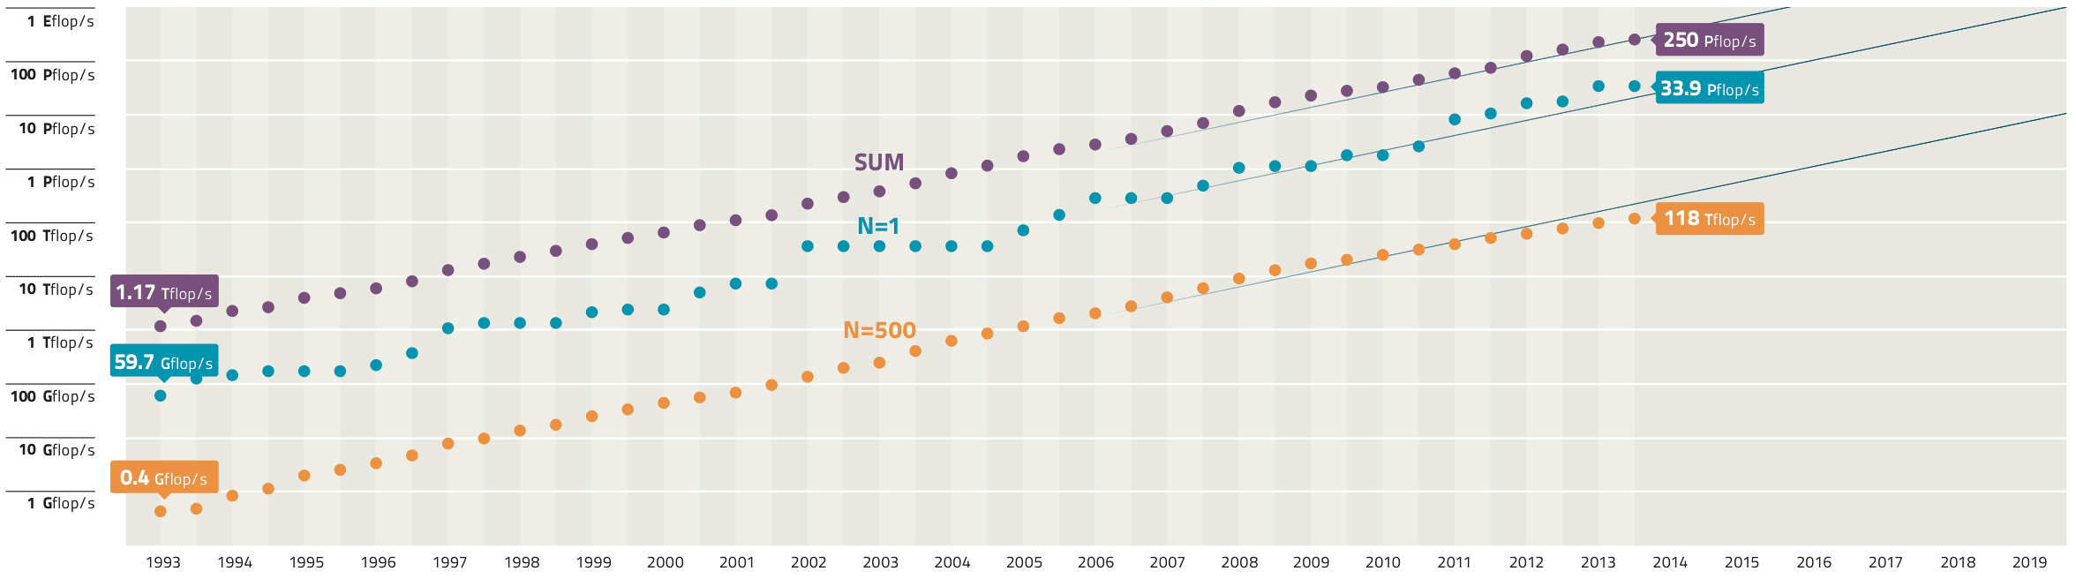
Motivation - Today
52Gflop/s
Mobile devices:
Widely adopted
Always-on
Always connected
Powerful Mobile Devices
Galaxy S4 - as powerful as a year 2000 super computer
Why do we still rely on servers?
Notes:
-Today’s phones e.g. galaxy s4 51 G flops = super computer in 2000
Why do we still rely on servers the internet
no technological reason that devices can’t connect directly to one another
Increase in # devices
Wireless network more and more available.
Smart phone widely adopted with wireless data.

Slide 5
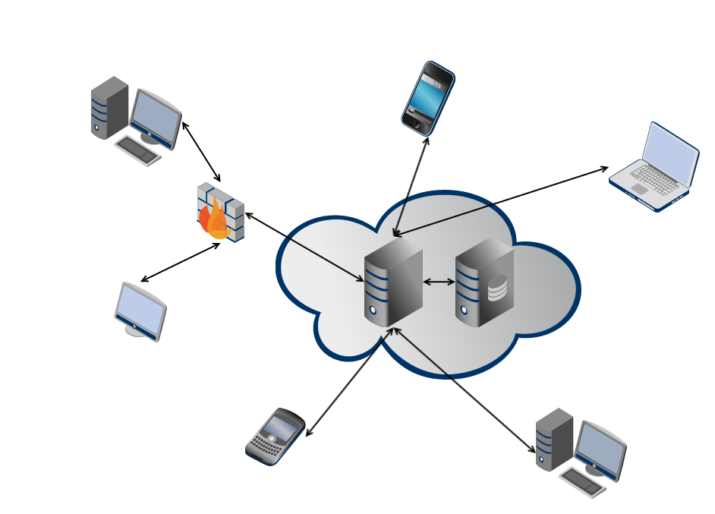
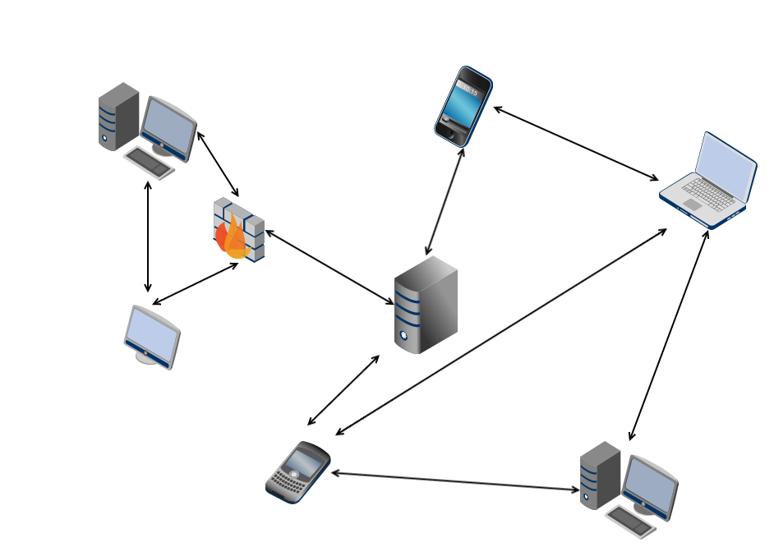
DIAS: Decentralizing Internet Applications and Services
Centralized Architecture
Single point of failure
✗ Privacy
✗ Security
✗ Energy efficiency
Decentralized Architecture
Robust to failure
Reclaim personal data
Power efficiency
Notes:
centralized servers have many drawbacks, ranging from
privacy, security, and fault-tolerance, to even energy-efficiency
and control over data
Decentralize the current server-client mode paradigm in the current Internet

Slide 6
DIAS Overview
Goal:
Decentralize the current server-client mode paradigm
Replace servers with point to point communication for personal communication and services
Benefits:
Security, Privacy, Resilience, Cost, and Power
Challenges:
Redundancy, Uptime, Failover
Notes:
How do we ensure reachability?
What happens if the cellphone loses connectivity?
What if it is lost/broken/stolen?
We need to find novel methods to ensure redundancy for both uptime and data.

Slide 7
Mission
Build a first generation decentralized architecture which supports typical personal communication and applications including:
Email
Web Pages
Social Networking
Chat

Slide 8
Related Work

Slide 9
Related Work
Peer to Peer Networks (P2P)
Connectivity and Reachability
Data Replication

Slide 10

Related Work – P2P
BitCoin
Open-source P2P money / payment system.
Low transaction cost, less risky, secure, etc.

Slide 11

Related Work – P2P
Bitcloud
Decentralizing the Internet, creating Distributed Applications, and developing a new mesh network to replace the Internet.
Improve privacy, security, and ending Internet censorship.

Slide 12
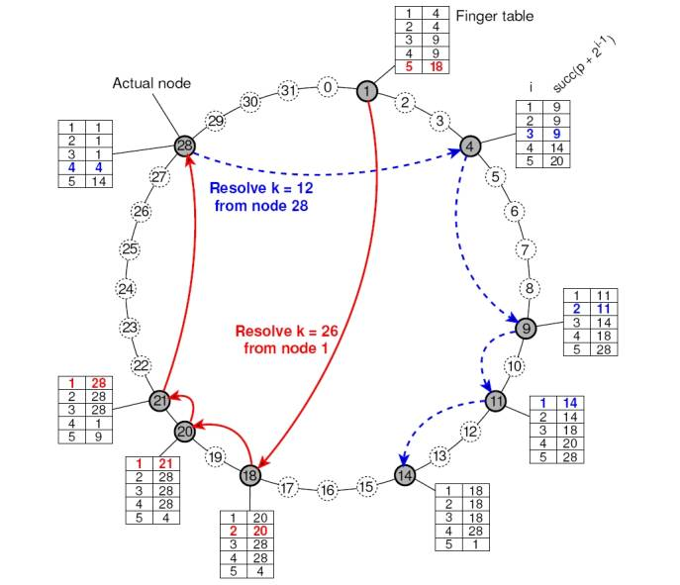
Related Work – P2P
Chord
Peer-to-peer lookup service for Internet applications
Each node maintains information for about O(logN) other nodes, resolves look up via O(logN) messages, and update routing information as nodes joining and leaving with O(log²N) messages

Slide 13
Related Work – Connectivity and Reachability
Connectivity and Reachability
Challenge
Cell phone providers block reachability.
Solutions
IPv6 (Mobile IP)
Approximately 3.4×10³⁸ addresses, 7.9×10²⁸ times as many as IPv4
The mobile nodes (as IPv6 nodes) change their point-of-attachment to the IPv6 Internet without changing their IP address.
Unmanaged Internet Architecture (UIA)
Conclusion
Largely solved issue
More for business reasons rather than technical
Not our main concern
Notes:
It is not enough for the device to have internet connectivity, but it must also be reachable from the internet.
Cell phone providers and WiFi access points hide their clients behind network address translation (NAT) or a firewall which blocks reachability from the internet.
UIA by MIT, solves the connectivity and reachability issue even in the current state of the internet, however it requires some assistance from devices with public IPs to enable NAT traversal.
[14] B. A. Ford, “Uia: a global connectivity architecture for mobile personal
devices,” Ph.D. dissertation, Massachusetts Institute of Technology,
2008.

Slide 14

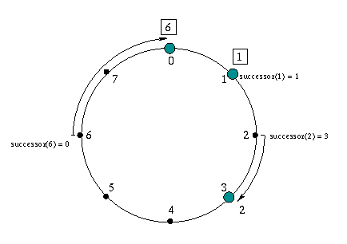
Related Work – Data Replication
Data replication in distributed systems, such as a Peer-To-Peer systems, where nodes are unreliable, additional considerations for the dynamic nature of nodes and data replication must be considered.
Decentralized P2P ﬁle sharing programs - replicate ﬁle data on end nodes, which may become corrupt or suffer from loss of availability
Limewire
Bittorrent
Kazaa
PAST
Built on Pastry
Replicates files close to owner’s nodes
Replicates entire files

Slide 15


Related Work – Data Replication
Plover - is a low-overhead ﬁle replication scheme for P2P networks that makes copies of ﬁles among physically close nodes based on capacities.
Content Delivery Networks
Replicate data near consumers.
Akami
Amazon S3

Slide 16
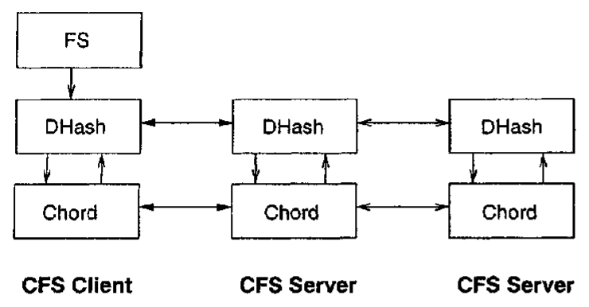
Related Work – Data Replication
Cooperative File System (CFS)
Peer-to-peer read-only storage system that provides provable guarantees for the efficiency, robustness, and load-balance of file storage and retrieval.
Built on Chord – Coordinated File System
Replicates files close to owner’s nodes
Replicates at block level to distribute the load and storage space among servers in the network.

Slide 17
DIAS Framework & Progress

Slide 18
DIAS Architecture
Building Blocks
Connectivity & Reachability
Naming and Domain Management
Integration
Android Application
Devices publically accessible
Basic Services
Full Communication
DNS
Failover
Web and Email services
Key Functionalities
Power Management
Data Replication
Smart Failover
Server Manager
Battery Power Monitoring

Slide 19
Building Blocks

Slide 20
Connectivity and Reachability
Reachability of devices has been previously addressed, but not widely deployed or accessible for deployment.
We utilize a VPN server running at RECG lab server
Allocate static public IPs to our devices
Our devices are publicly accessible
As discussed in
Section II-C, existing work has already addressed, and largely
solved, this issue, thus it will not be our focus. Unfortunately
these methods have not been widely deployed, are blocked, or
have only been tested in lab settings. To bypass this challenge,
we intend to use a VPN server, such as OpenVPN [22],
running on an RECG lab server to allocate static public IPs to
our devices.
devices to be
publicly accessible, as well as provide a reliable way for them
to communicate with each other.

Slide 21
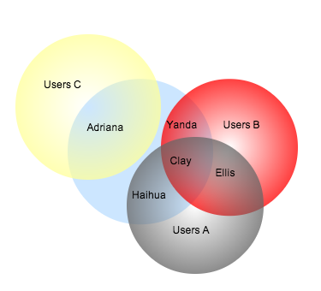
Naming and Management
DNS
Dynamic DNS
Human friendly names
Help with load balancing and failover
Identify our personal clusters
Self-own laptop, smartphone, desktop, tablet, etc.
Clever self failover technique
Establish a failover order self-own devices
Conventional DNS provides human friendly names as well as domain management, and, in
more advanced systems can also provide load-balancing and failover.
In our architecture we will additionally use it help specify our personal ”‘mini-clusters”’ and failover order.

Slide 22
Communication Services
Utilize open-source server software, provide basis for our communication services.
Email Server
Web server
Other services…
Guarantee:
Full communication and service
Backwards compatibility
open-source server software, such as postfix, sendmail, apache,
etc., which will provide the basis of our communication ser-
vices.
full communication
and service, which are even backwards compatible with the
existing email and web services.

Slide 23
Integration

Slide 24
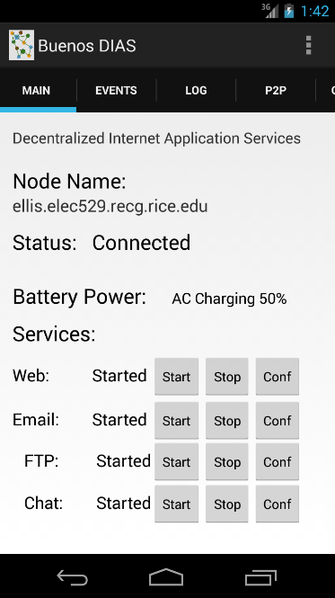
Android Application
Event and Debug Logs and Configuration Tabs
Configurable Node Name
Connection and Overall Status Monitoring Thread/Event Receiver
Battery Power Monitoring Thread and Event Broadcast Receiver
Can act on power changes.
Pluggable Services List
Services can provide Start, Stop, and Configuration methods.
Web, Email, FTP, etc.

Slide 25
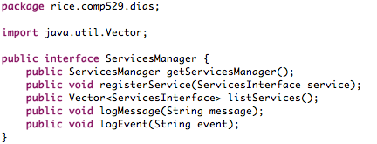
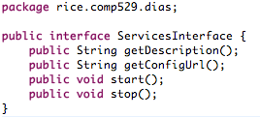



Web
Email
Other Services

Slide 26
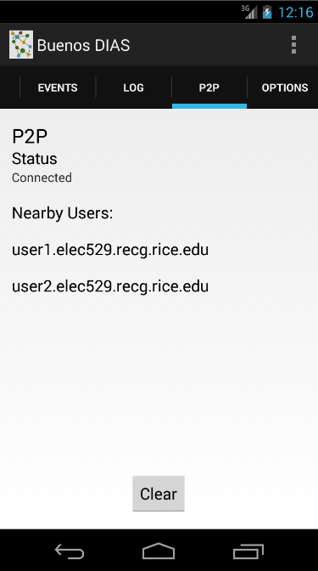
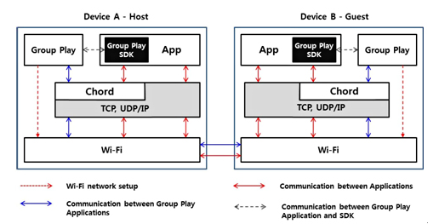
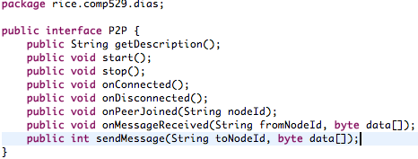
Samsung Group Play SDK Utilizes Chord
However, it is closed source and doesn’t execute outside of Android SDK. Chord SDK Discontinued
Facade
P2P Interface
Chord
Pastry
…

Slide 27
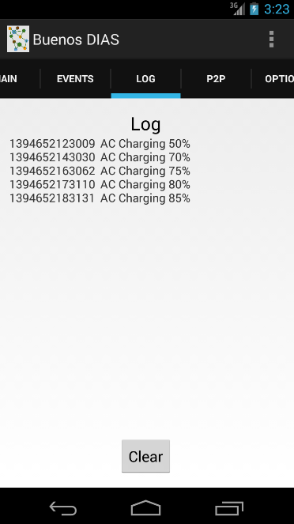
Battery Power Monitoring
Event Log for asynchronous events received from the device such as, network and battery levels. It also logs events for pluggable services and building blocks.
Debug Log contains debug messages from monitoring threads and services.
Android application can react to changes in the battery level or network events.
It has monitoring threads for battery and network connections, and depending on thresholds, the application will be able to react and shutdown services or send notification messages.

Slide 28

Galaxy S4 Running DIAS
Dynamic DNS -> Local WiFi
ellis.route404.com
i-jetty, kirium, dyn-dns client
Web server sent over WiFi
2.35 GB Data / 2hrs
Can effectively monitor power levels with resource monitor threads. Can react to resource changes.

Slide 29
DIAS Architecture
Building Blocks
Connectivity & Reachability
Naming and Domain Management
Integration
Android Application
Devices publically accessible
Basic Services
Full Communication
DNS
Failover
Web and Email services
Key Functionalities
Power Management
Data Replication
Smart Failover
Server Manager
Battery Power Monitoring

Slide 30
Progress
Building Blocks
Connectivity & Reachability
Naming and Domain Management
Integration
Android Application
Devices publically accessible
Basic Services
Full Communication
DNS
Failover
Web and Email services
Key Functionalities
Power Management
Data Replication
Smart Failover
Server Manager
Battery Power Monitoring
✓
✓
✓
✓
✓

Slide 31
Demo

Slide 32
Website hosted by our phones
Go to:
http://clay.elec529.recg.rice.edu:8080/
http://adriana.elec529.recg.rice.edu:8080/
Over Rice Owls WiFi Go To: http://ellis.route404.com:8080/
Failover:
Adriana
http://1.clay.elec529.recg.rice.edu:8080/
Clay
http://3.adriana.elec529.recg.rice.edu:8080/

Slide 33
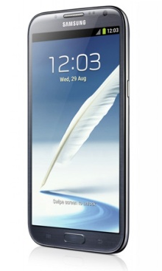
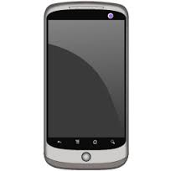
Demo Network Architecture
VPN
Cellular
Network
http://clay.elec529.recg.rice.edu:8080/
http://adriana.elec529.recg.rice.edu:8080/
http://ellis.elec529.recg.rice.edu:8080/
Dr. Ng

Slide 34
Remaining Work

Slide 35
Proposed Timeline
March Early
March Mid
March End
Framework Setup
Get connectivity and reachability on phones
VPN server with public IPs and DNS
Servers installation (Web and Email)
Mid-term Presentation
Basic experimental framework installed
Start working on novel issues (replication, failover, and power).
Data Replication:
Basic replication scheme working
✓
✓
✓

Slide 36
Proposed Timeline
April
Early
April
Mid
April
End
Failover:
Basic mechanism develop and implemented
Power:
Experiment with performance and power analysis
Final Presentation:
Polish and integrate results into final presentation

Slide 37
Remaining Work
Finish Android Application with full functionality
Data replication
Failover handling
Power management

Slide 38
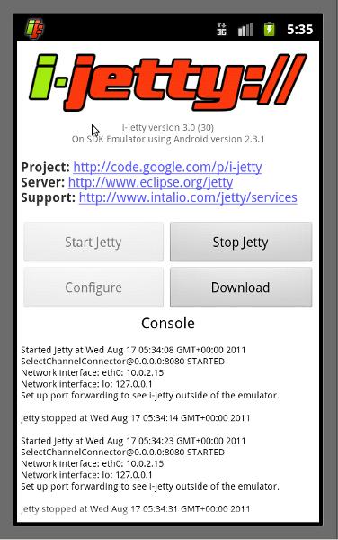
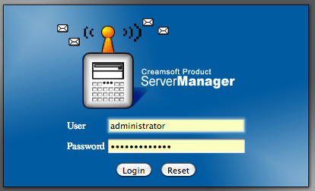
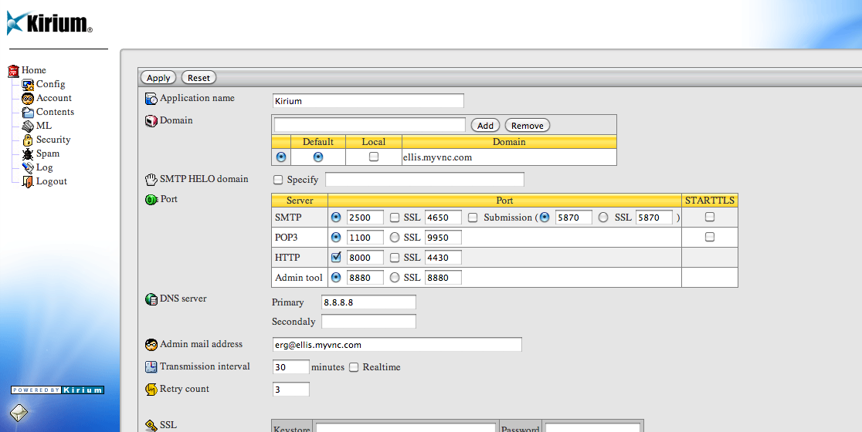
Backup

Slide 39
. You must use slides. File format is up to you (e.g. ppt, pdf, etc)
. You must submit your slides on Owlspace (this assignment) before the class begins
. Use 5 minutes to motivate the problem/question that you want to address
. Use 2 minutes to summarize relevant related work
. Use 8 minutes to outline your new solution or approach to addressing the problem/question
. Use 8 minutes to describe your progress/findings so far
. Use 2 minutes to describe your remaining work
. 5 minutes of Q&A will follow your presentation

